Slide 1

SUPPORT MODEL
STREAM vs SWARM

Slide 2

Introduction
Structure of Models (How they work)
Stream Model
Swarm Model
OVERVIEW
Advantages And Disadvantages of implementing Models
How Does These Apply To Our Work Bethel or As Remote Volunteers

Slide 3
INTRODUCTION
What is Stream and Swarm support Model?
Stream Support Model
Swarm Support Model
Escalation Based Process
Collaboration Based Process
WHY ARE WE DISCUSSING THIS SUBJECT?
Notes:
Understanding the support model the organization is using, will assist all as support persons work collaborative to as a team, not as a standalone groups.

Slide 4
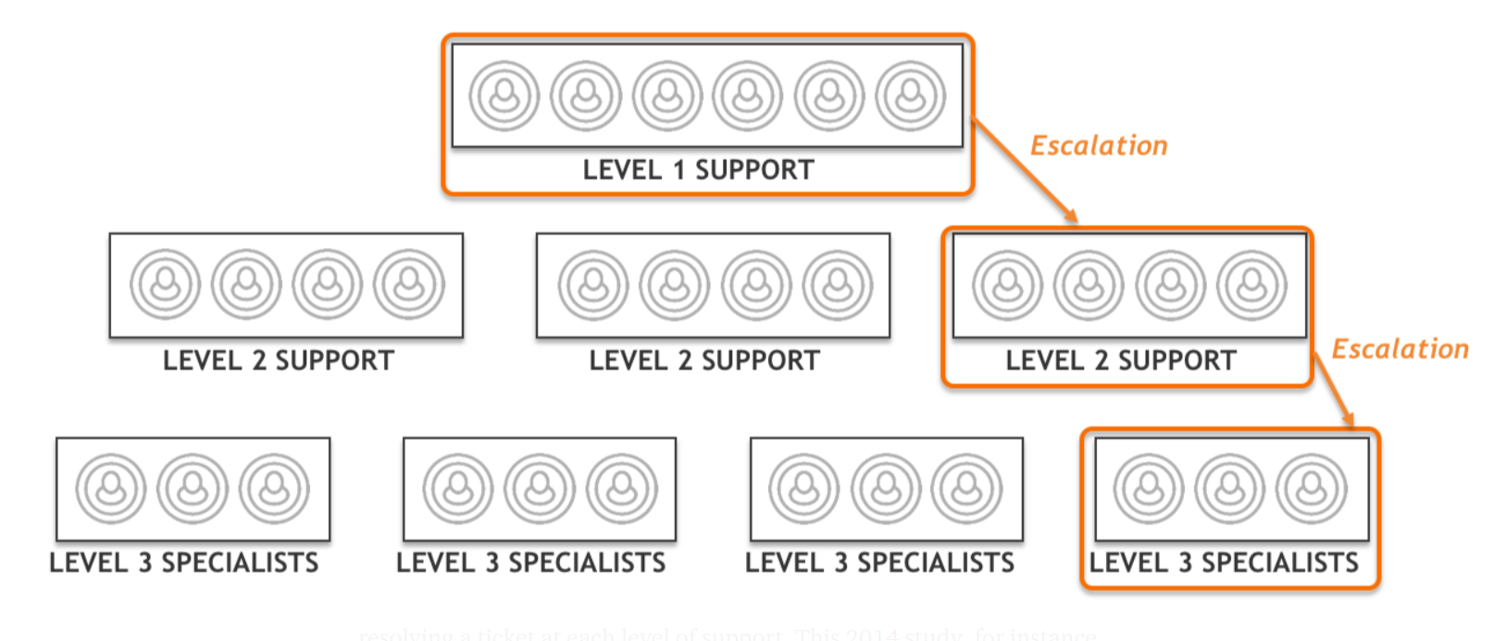
Model Structure - Streaming
Streaming Structure is divided into 3 level support Called Three-tier support.
Notes:
Q1. Who in the class can help to explain how this support model works? (2 or 3 persons)
Level 1 - A frontline Service Desk, directly fielding incoming customer communication (typically by answering phone calls). Most Service Desks are set up to provide a moderate level of generalised technical support, with the aims of presenting a consistent level of customer support to users, while resolving a significant number of incoming issues at the first-line.
Level 2 - A second tier of support, often closely associated to the Service Desk, but with deeper general or specialist skills

Slide 5
Model Structure - Streaming
Help Desk.
(first contact with users, Assisting in solving issues, Assigning incidents)
Notes:
Level 1: Represent our helpdesk: we handled calls, assist users in solving tasks, routing of calls to appropriate department, Creating and assigning incidents. etc

Slide 6
Model Structure - Streaming
Help Desk Field Support Technician
Notes:
Level 1: Represen

Slide 7
Model Structure - Streaming
Application support, Administrative support,
Network support,
Server support, Hardware Support
Notes:
Level 3: This represent the different teams we have In computer department. This could also be referred to as an expert in some specialize software or hardware.

Slide 8
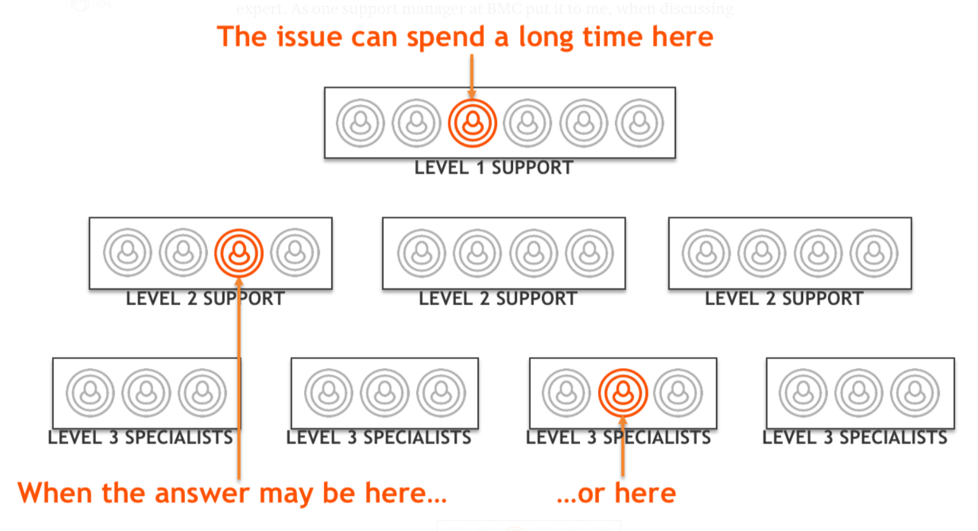
Model Structure - Streaming (Challenges)
Notes:
Q. What could be the advantage and disadvantages of this model?
Points:
Tiered Support creates multiple queues. While Level 1 support tends to be reactive and realtime, any case that can not be resolved at this level immediately enters a queue. Its nature changes, turning it from a current activity into a backlog item. Level 2 and 3 are stores of work in progress.

Slide 9
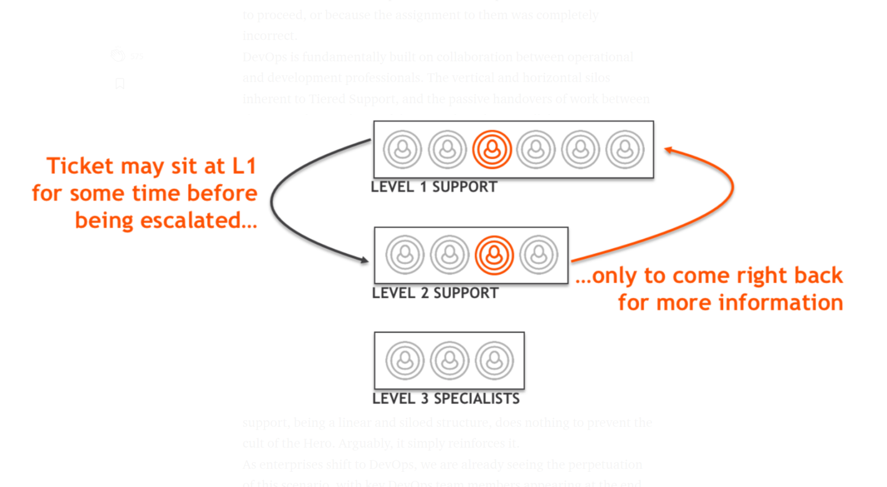
Model Structure - Streaming (Challenges)
Notes:
Q. What could be the advantage and disadvantages of this model?
Tiered Support leads to cases “bouncing” In tiered support, the method of moving a case between them is simply to change the team which is assigned to it. This step is typically carried out unilaterally by the assigning team to the assignee team. The first time the new assignee sees the case ticket is when it arrives in their queue. Unfortunately, it is very common to see the ticket bouncing right back, either because the more specialised team requires further information to proceed, or because the assignment to them was completely incorrect.

Slide 10
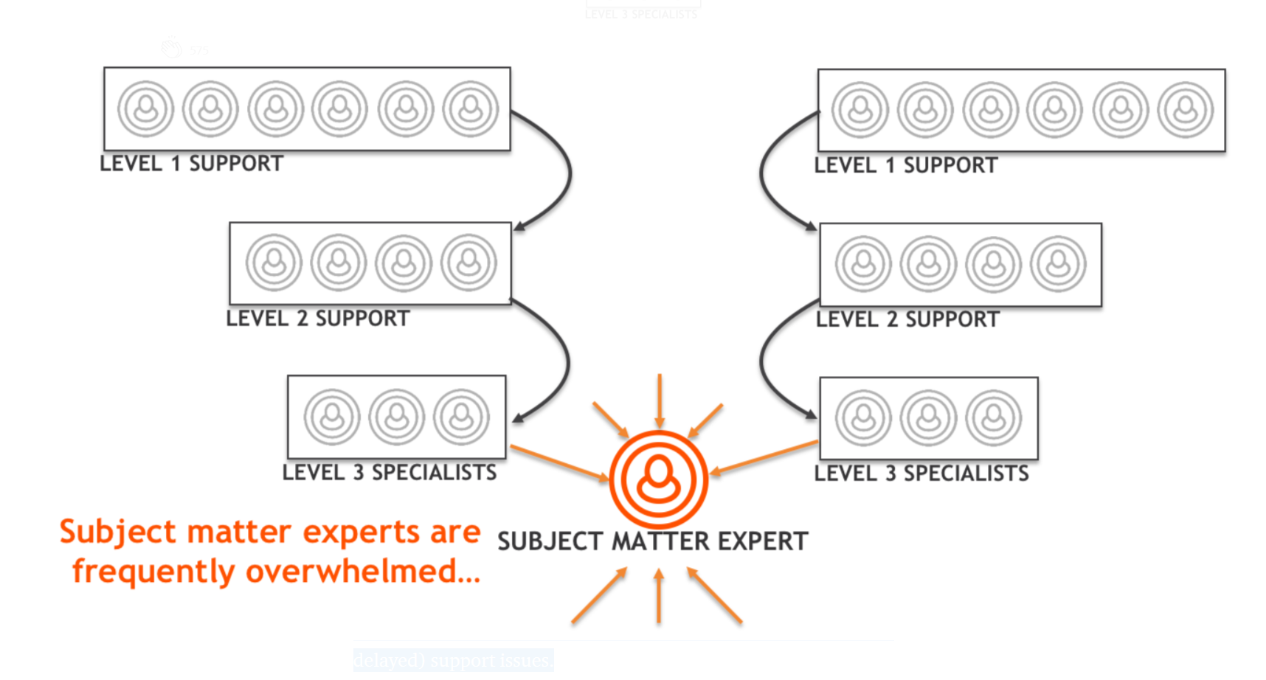
Model Structure - Streaming (Challenges)
Subject Matter
Notes:
Q1. Who are the subject matter experts in our department?
Q2. Who can we call the subject experts
Tiered Support does not solve the problem of Subject Matter Experts becoming overwhelmed
key developers are taken away from innovation to deal with a firehose of escalated (and already delayed) support issues.

Slide 11
Model Structure – Swarming (Core Principles)
There Should be no escalation from one group to another.
Collaboration
The case should move directly to the person most likely to be able to resolve it.
The person who takes the case is the one who sees it through to resolution.
Notes:
Q1. what do we think Swarming Model is all about?
Q2. How does each of the statement means?
Q3. with this core principle in mind, what do we think will be the primary focus of this model support?
Speaker Note:
Each Swarm is actually a small team, focused in near-realtime on the incoming flow of customer cases.
Primary Focus: Provide immediate response, and resolve as soon as possible

Slide 12
Model Structure – Swarming (Core Principles)
“Cherry Pickers”. What new tickets can be resolved immediately.
Collaboration
Validation of tickets before assignment of product line support teams
Notes:
Q1. what do we think Swarming Model is all about?
Q2. How does each of the statement means?
Q3. with this core principle in mind, what do we think will be the primary focus of this model support?
Q4. What if the issue cannot be resolved during the collaboration period, What should be the next thing to do.
Speaker Note:
Each Swarm is actually a small team, focused in near-realtime on the incoming flow of customer cases.
Primary Focus: Provide immediate response, and resolve as soon as possible

Slide 13
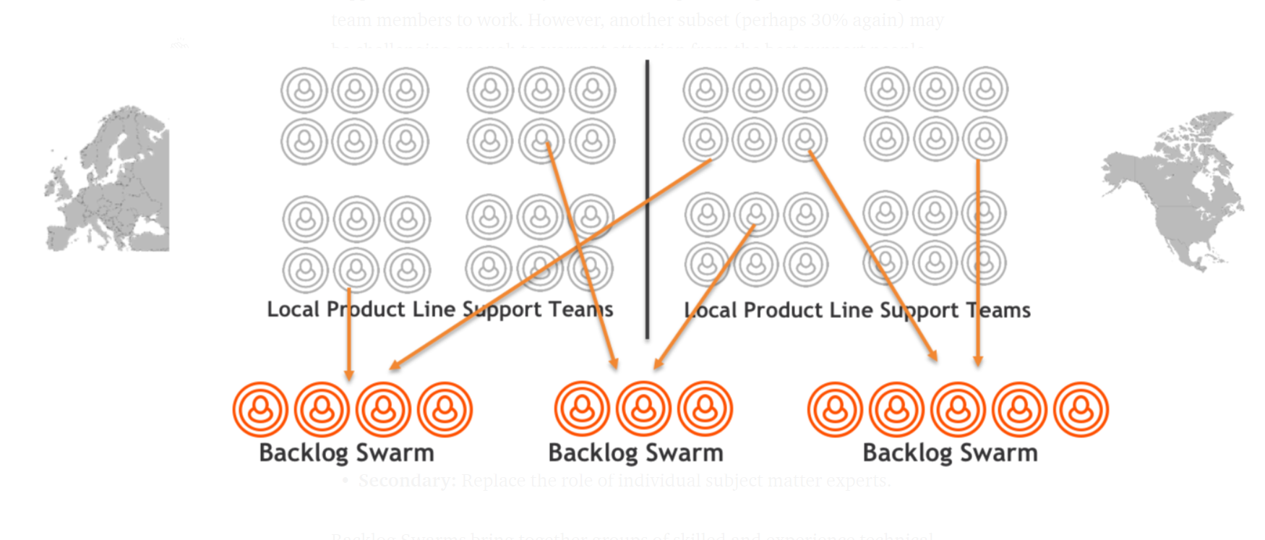
Model Structure – Swarming (Escalation Phases)
Backlog Swarm
Notes:
Backlog Swarm
Primary Focus: Address challenging tickets brought to them by product-line support teams
Backlog Swarms bring together groups of skilled and experience technical people, crossing boundaries such as geography and department, with the objective of focusing on the most difficult cases. Cases are referred to them by local engineering and support teams, who are no longer permitted to directly engage individual subject matter experts. They must, instead, always refer those cases to the appropriate Backlog Swarm.

Slide 14
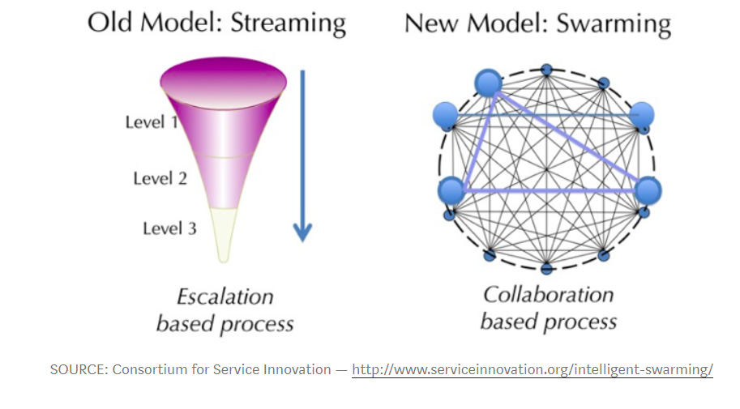
Model Structure – Streaming And Swarming
Notes:
Q1. Which of these model do we use here at the branch?

Slide 15









How Does These Apply to Our Work at Bethel?
The person who takes the case is the one who sees it through to resolution.
What Will be the next step?
Network Issue
Firewall Issues
User
HD
FSA
SSA
NSA

Slide 16
Model Structure - Streaming (Challenges)
Notes:
Tiered Support does not solve the problem of Subject Matter Experts becoming overwhelmed
key developers are taken away from innovation to deal with a firehose of escalated (and already delayed) support issues.

Slide 17

STREAM vs SWARM

